Slide 1
Predicting Driver Type – Use Case Slides
Elena Lowery, IBM Analytics Architect

Slide 2
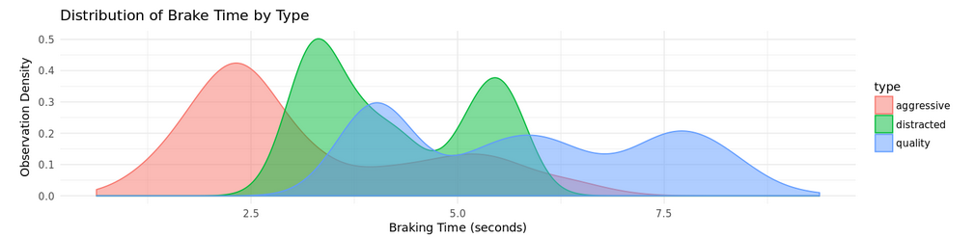
Demo use case: Data Science for Automotive Industry
Problem statement
The service bays at dealerships have seen an increase in warranty claims related to brakes. Using historical telematics data of known driver types, can we classify the driving style of customers making warranty claims?
Notes:
In our demo we will show how you can implement real time analytics to predict customer churn in Data Science Experience. Customer churn is not always predicted in real time, the deployment option depends on the type of data we are using to predict churn, but for our demo let’s assume that we want to integrate analytics with the Call Center application.
We are assuming that we are collecting some data in real time and therefore we will deploy the model that we create for real time scoring.

Slide 3
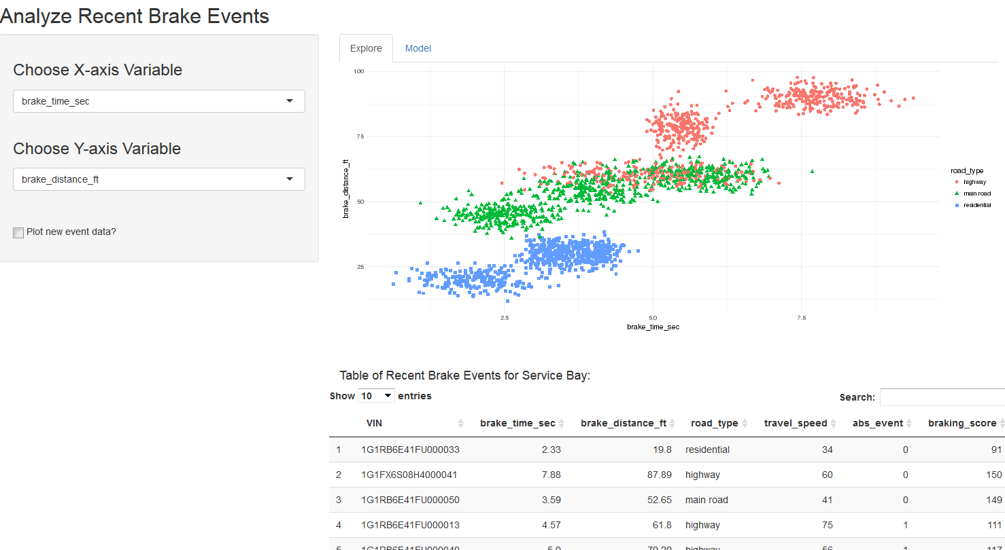
Implementation steps
In DSX
If using R
Analyze data and build a predictive model in a notebook
Save the model in a file
Import model file into Shiny
Run Shiny from RStudio to show data exploration and scoring

